Slide 1
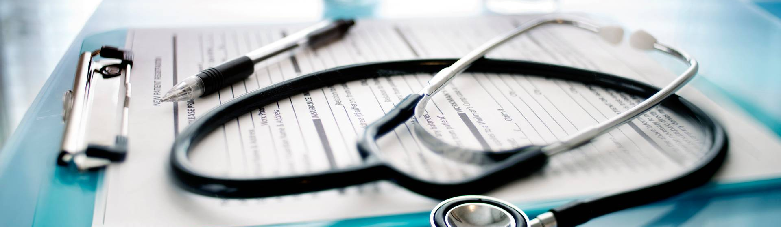
Mini project (Medicine recommendation system) Naina 2118815

Slide 2
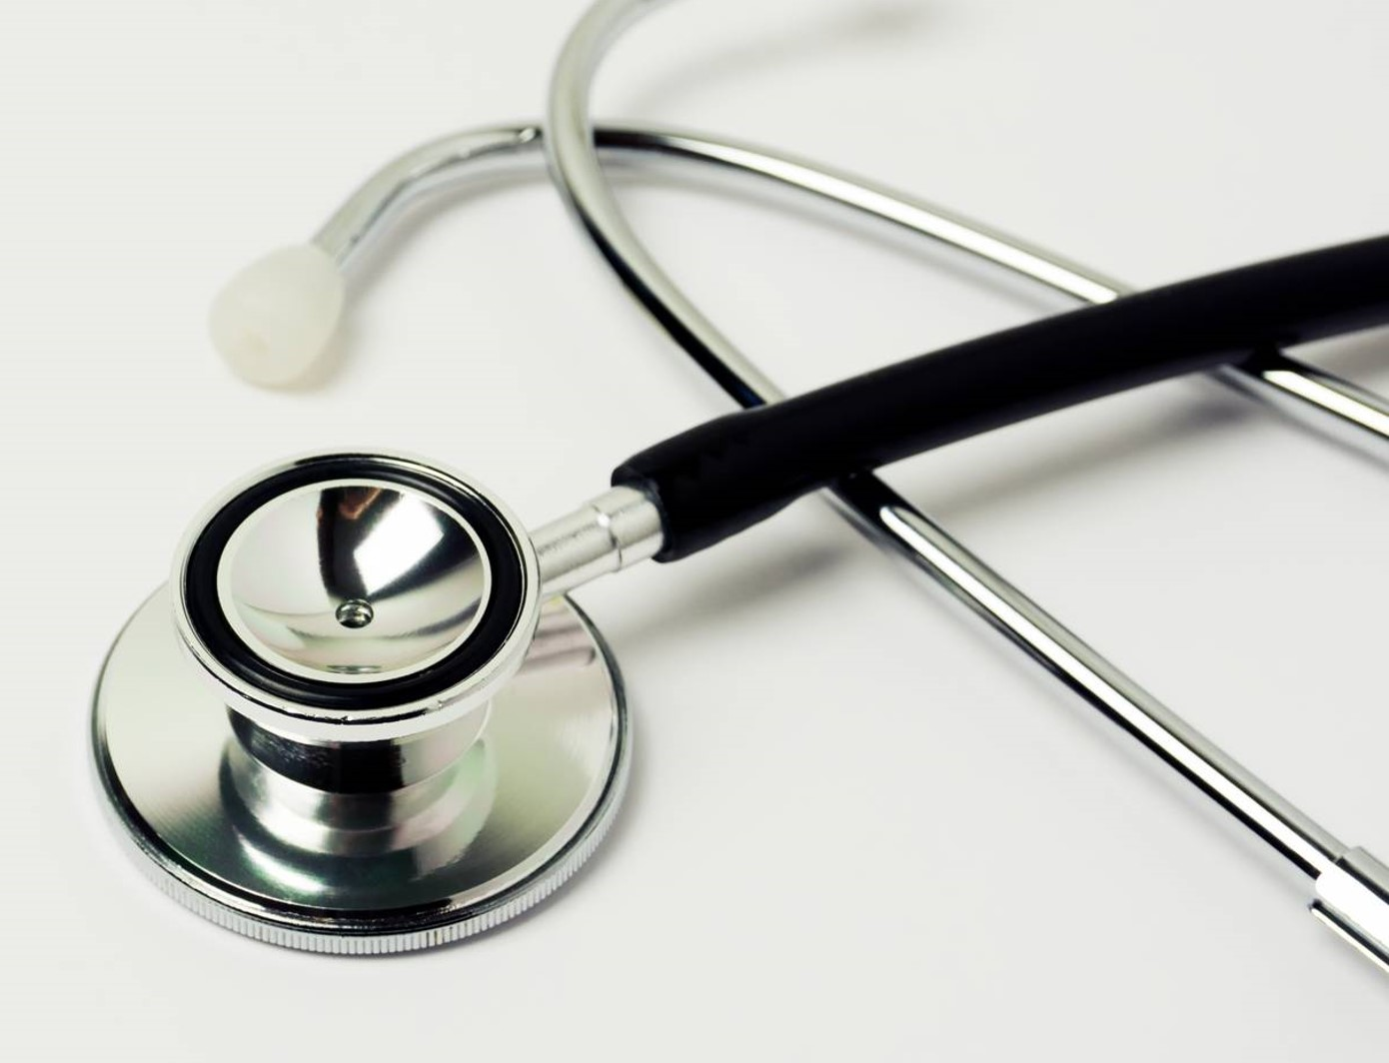
Description
Introduction
Role of AI
Problem Statement
Objective
Motivation
Tools Used
About
Discussion
Conclusion

Slide 3
Introduction
The integration of artificial intelligence (AI) and machine learning (ML) in healthcare has led to the development of sophisticated disease prediction and recommendation systems. These systems aim to enhance early diagnosis, provide personalized treatment plans, and improve overall patient outcomes. By leveraging vast amounts of data, AI systems can uncover patterns, predict outcomes, and provide insights that are beyond human capabilities.

Slide 4

Role of AI in Healthcare
Medical Imaging
Disease Prediction
Personalized Medicine
Workflow Optimization
Resource Management
Robotic Surgery
Virtual Health Assistants

Slide 5
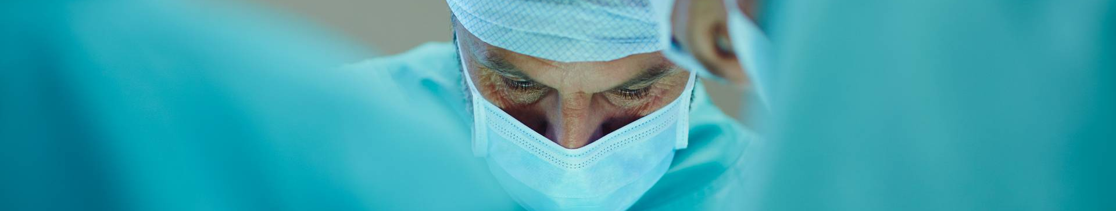
Problem statement
Develop a comprehensive AI-driven Disease Prediction and Recommendation System designed to assist healthcare providers in accurately diagnosing diseases and recommending treatment plans. The system aims to utilize vast amounts of healthcare data, including patient records, medical histories, imaging, lab results, and genetic information, to predict the likelihood of diseases and suggest appropriate interventions.

Slide 6
Objective
Develop Predictive Models: Create machine learning models capable of predicting the likelihood of various diseases based on patient data.
Early Detection: Enable early diagnosis of diseases to improve treatment outcomes and reduce healthcare costs. Risk Stratification: Identify high-risk patients for proactive monitoring and preventive measures
Personalized Recommendations Provide personalized treatment recommendations based on individual patient data, including medical history, lifestyle, and genetic factors.

Slide 7
motivation
Addressing unmet medical needs:
Early Detection of Diseases Many diseases, including cancer, cardiovascular diseases, and diabetes, have better treatment outcomes when detected early. By utilizing AI to predict diseases at an early stage, this system can significantly enhance early intervention strategies.
Reducing Diagnostic Errors Diagnostic errors are a substantial issue in healthcare, leading to inappropriate treatments and adverse patient outcomes. AI can assist in reducing these errors by providing more accurate and data-driven diagnoses.
Enhancing medical requirement:
Personalized Medicine Every patient is unique, and treatments that are effective for one person may not work for another. This system aims to tailor recommendations based on individual patient data, leading to more effective and personalized healthcare.
Preventive Healthcare By identifying individuals at risk of developing certain conditions, the system can recommend preventive measures, potentially reducing the incidence of chronic diseases and improving overall public health.
Contribution to medical research:
Advancing Medical Knowledge The data and insights generated by the system can contribute to medical research, helping to uncover new patterns and associations in disease development and treatment.

Slide 8
tools
Programming Languages
Python: Pandas, Numpy, Scipy
HTML
Feature Selection and Creation
Python Libraries: Scikit-learn
Dimensionality Reduction
Python Libraries: Scikit-learn.

Slide 9
tools
Machine Learning Frameworks
Scikit-learn: General-purpose machine learning library.
Integrated Development Environments (IDEs)
Jupter Notebook
PyCharm
Recommendation Algorithms
Content Based Filtering: Scikit-learn

Slide 10
about
Disease Prediction Module deals with choosing the suitable algorithm to be deployed on the data. The data which has been cleaned is fragmented into two parts. The first part of the dataset is called the training data and it is used for developing the model. The second part of the dataset is called the test data, and is used as a reference to test the model. Models like Logistic Regression, Random Forest, Gradient Boosting Classifier, Naive Bayes and SVC have been applied on the training dataset. This was followed by testing of the model by applying it on the testing dataset. Later the accuracy was given. But, the accuracy turned out to be zero. The reason why this particular model behaved that way was due to the reason that it does not have any first-hand knowledge of disease prior to the testing of it. Different classification algorithms are imported from the specific libraries and deployed on the dataset. After this, the model is evaluated on the testing dataset. The algorithm with highest accuracy is used to predict the diseases.

Slide 11

discussion
What Machine learning algorithms are used in the diagnosis of heart disease?
How can Machine Learning techniques be used to minimize misdiagnosis (additional tests, and wrong treatment all resulting in greater monetary impact to the patient)?
How can Machine Learning be used to detect early abnormalities, thus benefiting both patients and the healthcare system?
What follows is the discussion of the findings and conclusion, followed by suggestions for areas for further study.

Slide 12
conclusion
Machine learning algorithms used in predicting heart disease are Naïve Bayes, Logistic Regression, Support Vector Machine, Gradient Boosting classifier, and Random Forest, concluding that these algorithms can achieve high accuracy in predicting heart disease.
Machine learning algorithms can analyze a large amount of data to assist medical professionals in making more informed decisions cost-effectively.
Machine Learning algorithms allowed us to analyze clinical data, draw relationships between diagnostic variables, design the predictive model, and tests it against the new case. The maximum percent using svm to predict and recommend diseases.
Machine learning and data mining techniques are a major turning point in medical diagnosis and this project has shown how important information from medical records can be utilized to diagnose diseases in patients. The project’s objective to explore how machine learning algorithms can be used in the diagnosis the disease and recommend the steps and precautions taken to cure that disease has been achieved by identifying 5 different algorithm .Additionally developing an optimized model with one of them. Finally, the model we built to predict disease can save enormous medical bills, improve diagnosis capability on large scale, and most importantly save lives.

Slide 13

Thank you
NAINA
2118815

